Slide 1

Mini atm

Slide 2

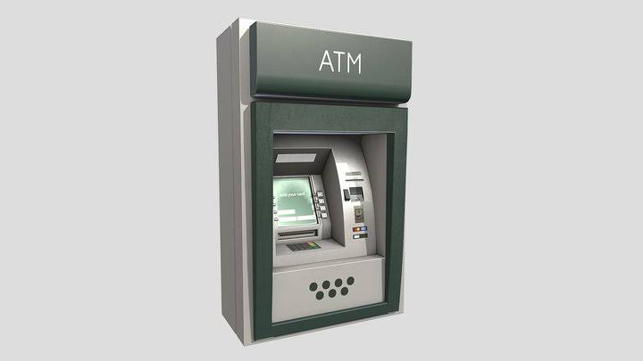
Atm machine Description:
 | A mini ATM, which stand for an Automated Teller Machine, is a specialized computer that makes it convenient to manage a bank account holder’s funds. It allow a person to check a balance, deposit, and withdraw a certain amount of cash balance. It also provides security using pin/password.

Slide 3
Input format:
For our program to run we input our pin number which is 1234. After that it will display a four option that will choose to execute.

Slide 4
OUTPUT FORMAT
We can only withdraw a certain amount cash balance. The limit will be just balance that we input.

Slide 5

Constraint: WE CAN ONLY WITHDRAW A CERTAIN AMOUNT OF CASH BALANCE. THE LIMIT WILL BE JUST THE BALANCE THAT WE INPUT.

Slide 6
SAMPLE INPUT:
Hello Welcome to UIBank
Please Insert Your CARD
Please Enter 4-digit PIN 1234
Enter number to proceed 1

Slide 7
Sample output
1 == account balance
2 == withdraw balance
3 == deposit
4 == exit

Slide 8

Explanation:
After running the code let the user insert the ATM card process for ​5 seconds. The system will ask the user to enter the 4-digit PIN and the number 1 to 4 options will appear. The user will enter the number to proceed. If the users enter the option number 1 it will appear the account balance. If the user enter option number 2 it will withdraw an amount of cash. If option number 3 is chosen by the user’s deposit cash. And the user can enter the option the number 4 if he/she wishes to exit.

